Slide 1
Leadership

Slide 2
Definition
“Leadership is a process by which individuals are influenced so that they will be prepared to participate in the achievement of organisational or group goals. It is the role of the leader to obtain the commitment of individuals to achieving these goals”

Slide 3
The Nature of Leadership
The Meaning of Leadership
  Process: what leaders actually do.
    Using noncoercive influence to shape the group’s or organization’s goals.
    Motivating others’ behavior toward goals.
    Helping to define organizational culture.
  Property: who leaders are.
    The set of characteristics attributed to individuals perceived to be leaders.
  Leaders
    People who can influence the behaviors of others without having to rely on force.
    People who are accepted as leaders by others.

Slide 4
Leaders/Managers
Leaders:
  Influence
  Inspire
  Motivate
  Energise
  Communicate
  Encourage
  Direct group towards achieving goals
Managers:
  Use authority to direct group
  Use rank
  Plan
  Organise
  Control

Slide 5
Fundamental Differences (Hollingsworth:1999)
Managers:
  Administer
  Maintains
  Focuses on systems and structure
  Relies on control
  Keeps an eye on the bottom line
  Does things right
Leaders:
  Innovate
  Develop
  Focuses on people
  Inspires trust
  Has an eye on the horizon
  Does the right thing

Slide 6


Leadership approaches - I
Trait approach
Behavioural
approach
Contingency
approach
Classification
New theory

Slide 7
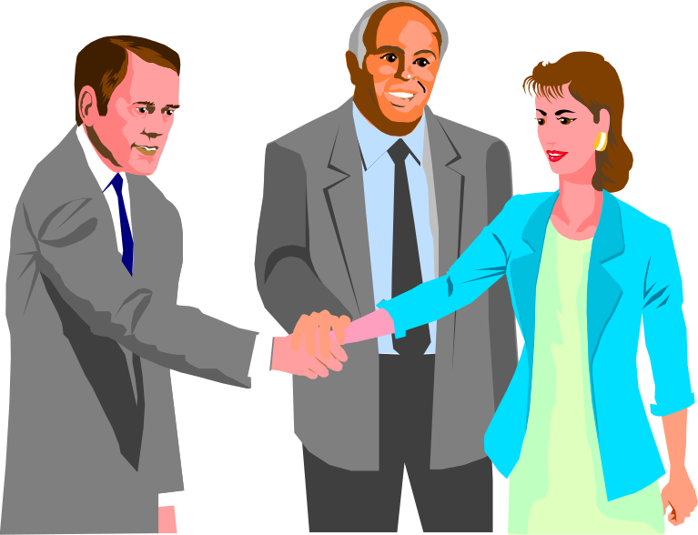
Leadership and managing diversity - I
The world is rapidly evolving into a global society. This poses significant challenges for the leader with respect to the management of…
Cultural diversity
Language diversity
Ethnic diversity
Religious diversity

Slide 8
Leadership and managing diversity - II
Diversity - threats and opportunities
THREATS
Conflict
Communication
barriers
Negative impact on
  productivity
  motivation
Loss of business opportunities
OPPORTUNITIES
Skill Diversity
Diversity of experience
Source of innovation
Source of creativity

Slide 9
1. Qualities or Traits Approach
The approach assumes leaders are born and not made.
Leadership consists of certain inherited characteristics or personality traits.
Focuses attention on the person in the job and not on the job itself.

Slide 10
2. Functional Approach
Attention is focused on the functions and responsibilities of leadership.
It focuses on the content of leadership i.e. what the leader actually does.
Assumes leadership skills can be learned and developed.
Looks at basic functions of the leader.

Slide 11
3. Behavioural Approach
This looks at the kinds of behaviour of people in leadership positions and the influence on group performance.
Draws attention to a range of possible managerial behaviour and importance of leadership styles.
Example: McGregor’s Theory X; Theory Y

Slide 12
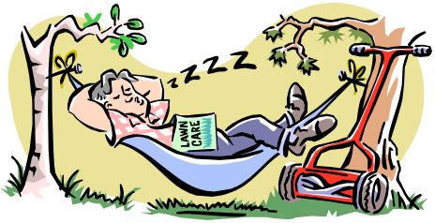

Douglas McGregor
Theory X & Y
Theory X
Theory Y
People are lazy
People lack ambition
Dislike responsibility
People are self-centered
People don’t like change
People are energetic
People want to make contributions
People do have ambition
People will seek responsibility

Slide 13
Theory X
Theory Y
People do not like work and try to avoid it.
People do not like work, so managers have to control, direct, coerce, and threaten employees to get them to meet organizational goals.
People prefer to be directed, to avoid responsibility, and to want security; they have little ambition.
Work is a natural part of people’s lives.
People are internally motivated by commitment.
People are committed to goals to the degree they receive rewards.
People will seek and accept responsibility.
People have the capacity to be innovative.
People are bright, but mostly under-utilized.
Notes:
24

Slide 14
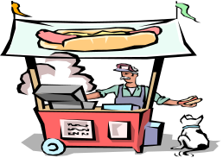

Abraham Maslow’s Hierarchy
General
Examples
Organizational
Examples
Self-
actualization
Self-fulfillment
Challenging Job
Status
Esteem
Job Title
Friendship
Belonging
Friends
Stability
Safety, Security
Retirement Plan
Shelter
Physiological
Wages
Based on needs satisfaction

Slide 15
Maslow’s Hierarchy of
Needs Theory
Self-Actualization
Needs
represent the need for
self-fulfillment
Esteem Needs
desire for a positive self-image
and to receive attention
Belongingness Needs
desire to be accepted by one’s peers
Safety Needs
safe and secure physical and emotional environment
Physiological Needs
most basic human physical needs

Slide 16
4. Leadership Styles
Concerned with the effects of leadership on those being led.
Examples:
  Lewin’s Iowa Study
  Tannenbaum and Schmidt’s Continuum of Leadership Styles
  Orientation models

Slide 17
5. Situational Leadership
Focuses on the different situations and the fact that there is no single style of leadership appropriate to all situations.
  Examples:
    Fiedler’s Contingency Model
    Situational Leadership Model
    Normative Leadership Model
    Path-Goal Theory

Slide 18
Fiedler’s Contingency Model
Leadership orientation will be effective when orientation suits the situation.
Fiedler proposes three factors which affect the ‘degree of favourability’ for a leader:
  Leader-member relations
  Task structure
  Position power

Slide 19
Motivators and Hygiene Factors
Frederick Herzberg theorized that two entirely separate dimensions contribute to an employee’s behavior at work—hygiene factors and motivators.
  Hygiene factors are elements such as working conditions, pay, policies, interpersonal relationships
  Motivators fulfill high-level needs and include achievement, recognition, responsibility and opportunity for growth

Slide 20
Motivators and Hygiene Factors
Motivators satisfy subordinates–-the things which encourage them to attend work, comply to group or team goals, and produce.
They often are linked to performance. Positive recognition by a superior and among peers during a formal meeting is an example of this.

Slide 21
Motivators and Hygiene Factors
Hygiene factors keep subordinates from being dissatisfied. They apply to subordinates regardless of performance.
  Timely and thorough completion of and counseling on fitness evaluations are an example of a hygiene factor.
  The act is expected. When it does not happen subordinates become dissatisfied and may come to believe that superiors are not taking care of them.
Satisfiers (motivators) and dissatisfiers (hygiene factors) lie on completely different scales and must be considered independently.

Slide 22
Maslow’s and Herzberg’s Theories
Overlapping features shared by both Maslow’s and Herzberg’s theories:
  Hygiene factors are predominantly related to lower level needs.
  Herzberg’s motivators target higher level needs.
  The very notion that dissatisfiers (hygiene factors) and satisfiers (motivators) must be dealt with distinctly is congruent with the distinction between basic needs and what satisfies them.

Slide 23
Motivation
Motivation is the willingness of a person to exert high levels of effort to satisfy some individual need or want.
  The effort is a measure of intensity.
  Need – Some internal state that makes certain outcomes appear attractive.

Slide 24
Herzberg’s Motivation-Hygiene Theory
Two independent scales:
  Satisfaction and No Satisfaction
    These are the motivators
  Dissatisfaction and No Dissatisfaction
    Hygiene or maintenance factors

Slide 25
Comparison of Hygiene and Motivators
Hygiene Factors
  Company policies
  Supervision
  Work conditions
  Salary
  Relationship with peers
  Status
  Security
  These factors contribute to job dissatisfaction.
Motivators
  Recognition
  Achievement
  Work itself
  Responsibility
  Opportunity for advancement
  Growth
  These factors contribute to job satisfaction.

Slide 26
Leadership Power Base Concepts
Positional Power
Personal Power
Relational Power

Slide 27
1. Positional Power
Reflects the power that a person has as a direct result of their job title, responsibilities and position or placement within an organisation or society.
  Formal authority – organisational hierarchy grants this authority.
  Control over critical resources – people whose activities are closely aligned with the corporate priorities.

Slide 28
2. Personal Power
Derived from an individual unique combination of personal attributes and skills. Examples of personal power:
  Ability to gain cooperation
  Ability to win when competitive situations arose
  Ability to support and gain support

Slide 29
3. Relational Power
Derived from relationships with others. Relationships can increase power by providing a source of emotional support, advice, information and tangible resources.
This power can be gained through:
  The degree of centrality experienced by leader
  The extent of the wide range of multiplex relationships (blurred between personal and professional)

Slide 30
Leadership Behaviors
Michigan Studies (Rensis Likert)
  Identified two forms of leader behavior
    Job-centered behavior—managers who pay close attention to subordinates’ work, explain work procedures, and are keenly interested in performance.
    Employee-centered behavior—managers who focus on the development of cohesive work groups and employee satisfaction.
    These two forms of leader behaviors
    were considered to be at opposite
    ends of the same continuum and
    similar to (respectively) Likert’s
    System 1 and System 4 of
    organizational design.

Slide 31

Leadership Behaviors (cont’d)
  Identified two basic leadership styles that can be exhibited simultaneously:
    Initiating-structure behavior—the leader
    clearly defines the leader-subordinate role
    expectations, formalizes communications,
    and sets the working agenda.
    Consideration behavior—the leader shows
    concern for subordinates and attempts to
    establish a friendly and supportive climate.

Slide 32
Leadership Behaviors (cont’d)
  Initial assumption was that leaders who exhibit high levels of both behaviors would be most effective leaders. Subsequent research indicated that:
    Employees of supervisors ranked highly on initiating structure were high performers, although they expressed low levels of satisfaction and had higher absenteeism.
    Employees of supervisors ranked highly on consideration had low- performance ratings, but they had high levels of satisfaction and had less absenteeism.
    Other situational variables were making consistent leader behavior predictions difficult.
    There is no universal or “one best way” model of leadership.

Slide 33
What are the trait and behavioral leadership perspectives?
Leadership Grid.
  Developed by Robert Blake and Jane Mouton.
  Built on dual emphasis of consideration and initiating structure.
  A 9 x 9 Grid (matrix) reflecting levels of concern for people and concern for task.
    1 reflects minimum concern.
    9 reflects maximum concern.

Slide 34
The Leadership Grid
High
9
(1,9) Country Club Manager
Team Manager (9,9)
Concern for People
(5,5) Organized-Person Manager
1
(1,1) Impoverished Manager
Sweatshop Manager (9,1)
Low
1
9
High
Concern for Production

Slide 35
Leadership Grid
High
9
1,9
Team Management
9,9
Country Club Management
Work accomplishment is
8
Thoughtful attention to
the
from committed people;
needs of people for satisfying
interdependence through
relationships leads to a
a “common stake” in
7
comfortable, friendly
organization purpose
The Leadership Grid® is a method of evaluating leadership styles. The Grid® is used to train managers so that they are simultaneously more concerned for people and for production (9,9 style on the Grid®).
organization atmosphere
leads to relationships
6
and work tempo.
of trust and respect.
Middle of the Road
5
Management
5,5
Concern for people
Adequate organization performance is
4
possible through balancing the necessity
to get out work with maintaining morale
of people at a satisfactory level.
Authority-Compliance
3
Efficiency in operations
results from arranging
2
Impoverished Management
conditions of work in
Exertion of minimum effort
such a way that
Source: From Leadership Dilemmas—Grid Solutions by Robert R. Blake and Anne Adams McCanse. (Formerly the Managerial Grid by Robert R. Blake and Jane S. Mouton.) Houston: Gulf Publishing Company, p. 29. Copyright © 1991 by Scientific Methods, Inc. Reproduced by permission of the owners.
1
1,1
to get required work done
human elements
9,1
is appropriate to sustain
interfere to a
organization membership.
minimum degree.
0
Low
1
2
3
4
5
6
7
8
9
Low
Concern for production
High
Figure 17.1

Slide 36
Leadership Continuum
Developed by Tannenbaum and Schmidt
Model identifies 7 leadership styles based on one’s use of boss-centered versus employee-centered leadership
Key factors (variables) in selecting a style:
  The Manager
  The Subordinates
  The Situation

Slide 37
Continuum of Leadership Behavior
Autocratic Style
Participative Style
Leader makes decision and announces it
Leader “sells” decision
Leader presents ideas and invites questions
Leader presents tentative decision subject to change
Leader presents problem, gets suggestions and makes decision
Leader defines limits and asks group to make decision
Leader permits subordi-nates to function within limits defined by leader
1
2
3
4
5
6
7

Slide 38
Leadership Continuum
Leadership Continuum (Tannenbaum and Schmidt)
  Variables influencing the decision-making continuum:
    Leader’s characteristics—value system, confidence in subordinates, personal inclinations, and feelings of security.
    Subordinates’ characteristics—independence needs, readiness for responsibility, tolerance of ambiguity, interest in the problem, understanding goals, knowledge, experience, and expectations.
    Situational Characteristics—type of organization, group effectiveness, the problem itself, and time pressures.

Slide 39
Situational Approaches to Leadership
Situational Models of Leader Behavior
  Assume that:
    Appropriate leader behavior varies from one situation to another.
    Key situational factors that are interacting to determine appropriate leader behavior can be identified.

Slide 40
Normative Leadership Theory
Model developed by Vroom and Yetton
Enables the user to select one of five leadership styles appropriate for the situation
Leadership Styles
Decide
Consult individually
Consult group
Facilitate
Delegate

Slide 41

Related Perspectives on Leadership (cont’d)
Charismatic Leadership (House)
  Charisma, an interpersonal attraction that inspires support and acceptance of a leader.
  Charismatic persons are more
  successful than noncharismatic
  persons.
  Charismatic leaders are
  self-confident, have a firm
  conviction in their belief
  and ideals, and possess
  a strong need to influence
  people.

Slide 42
How do “Traditional” Leaders influence people?
Focus on Task & Control
Notice what’s wrong
Carrot & stick motivation
Sink or swim
Rigid - my way
Compromise
Pressure to ‘buy-in’
Avoid conflict

Slide 43
Basic Leadership Styles
Autocratic
  The leader makes the decisions and closely supervises employees
Democratic
  The leader allows participation in decisions and does not closely supervise employees
Laissez-Faire
  The leader takes a leave-the-employees-alone approach

Slide 44
Characteristics of Successful Leaders
Trait or Characteristic
Drive
Honesty and integrity
Leadership motivation
Self-confidence
Cognitive ability
Knowledge of the business
Creativity
Flexibility
Description
Desire for achievement; ambition; high energy;
tenacity; initiative
Trustworthy; reliable; open
Desire to exercise influence over others to reach shared goals
Trust in own abilities
Intelligence; ability to integrate and interpret large amounts of information
Knowledge of industry, relevant technical matters
Originality
Ability to adapt to needs of followers and
requirements of situation
-1
Notes:
3

